Slide 1
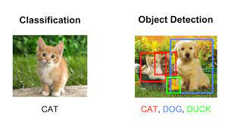
object detection:
Object detection is the locating and classifying object in an image.
Classification:
One object and one label per image, its matching one label to one image.

Slide 2
Yolo (you only looks once):
Instead of making predictions on many regions of an image, yolo passes the entire image at once into an CNN.
The CNN that predicts the labels, bounding boxes, and confidence probabilities for objects in the image.

Slide 3
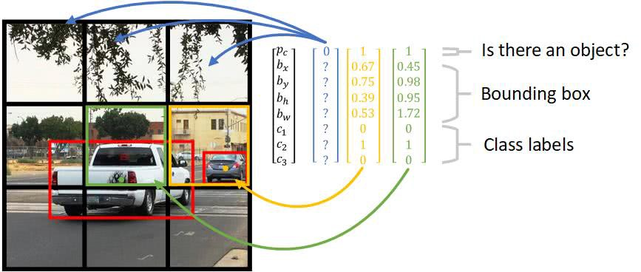
Yolo Steps:
Divide the image into cells with an s*s grid.

Slide 4
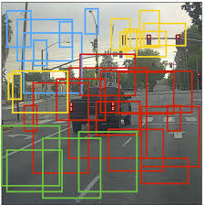
Each cell predicts B bounding boxes, B is equal to two so each cell is filled with two boxes. And what we mean by each cell is responsible for keeping two bounding boxes is that the centre of the bounding box also within the cell and that cell should predict that bounding box. A cell is responsible for detecting an object if the objects bounding box falls within the cell.(note that each cell has two centre points.)

Slide 5
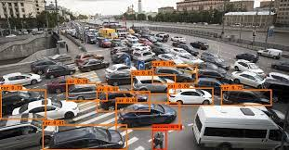
Return bounding boxes with confidence threshold. In second step what happens you see there’s a lot of different bounding boxes there that don’t contain anything.so we would set some confidence threshold, anything below the confidence interval is just get removed and we return when the boxes of the confidence interval. all the boxes are gone and then this box, which has a higher confidence interval should go there, would be returned and the rest of these will go somewhere else.

Slide 6
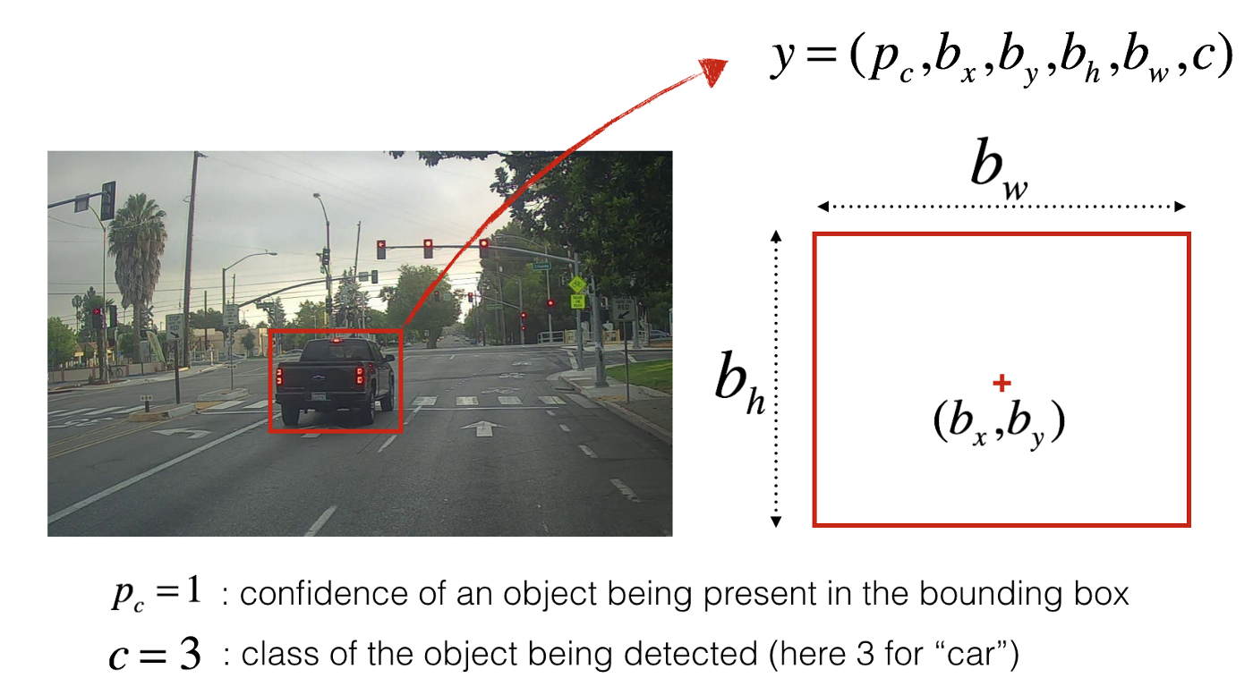
How bounding boxes are encoded: Lets use a simple example where there are 3*3 cells (s=3),each cell predicts 1 bounding box(b=1) and objects are either dog=1 or car=2 for each cell, cnn predicts a vector y.

Slide 7
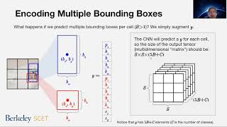
Encoding multiple bounding boxes: what happens if we predict multiple bounding boxes per cell (B>1).we simply augment y. Notice that y has 5B+c elements(c is the number of classes).

Slide 8
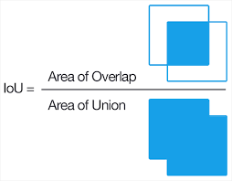
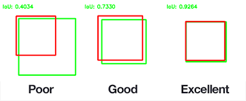
Measuring performance with IOU: Intersection over union (IOU) measures the overlap between two bounding boxes. During the training ,we calculate the IOU between a actual bounding box and predicted bounding box.

Slide 9
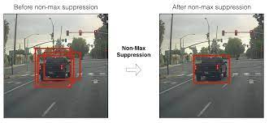
Double counting objects(non-max SUPPRESSION): Sometimes the same object will be detected multiple times. Non-max suppression solves multiple counting by removing the box with lower confidence probability when the iou between 2 boxes with the same label is above some threshold. 1. Identifying the box with the highest confidence. 2. Calculate the iou between the highest confidence box each of the other boxes. 3. Suppress boxes with iou above a selected threshold(usually 0.3).

